Slide 1
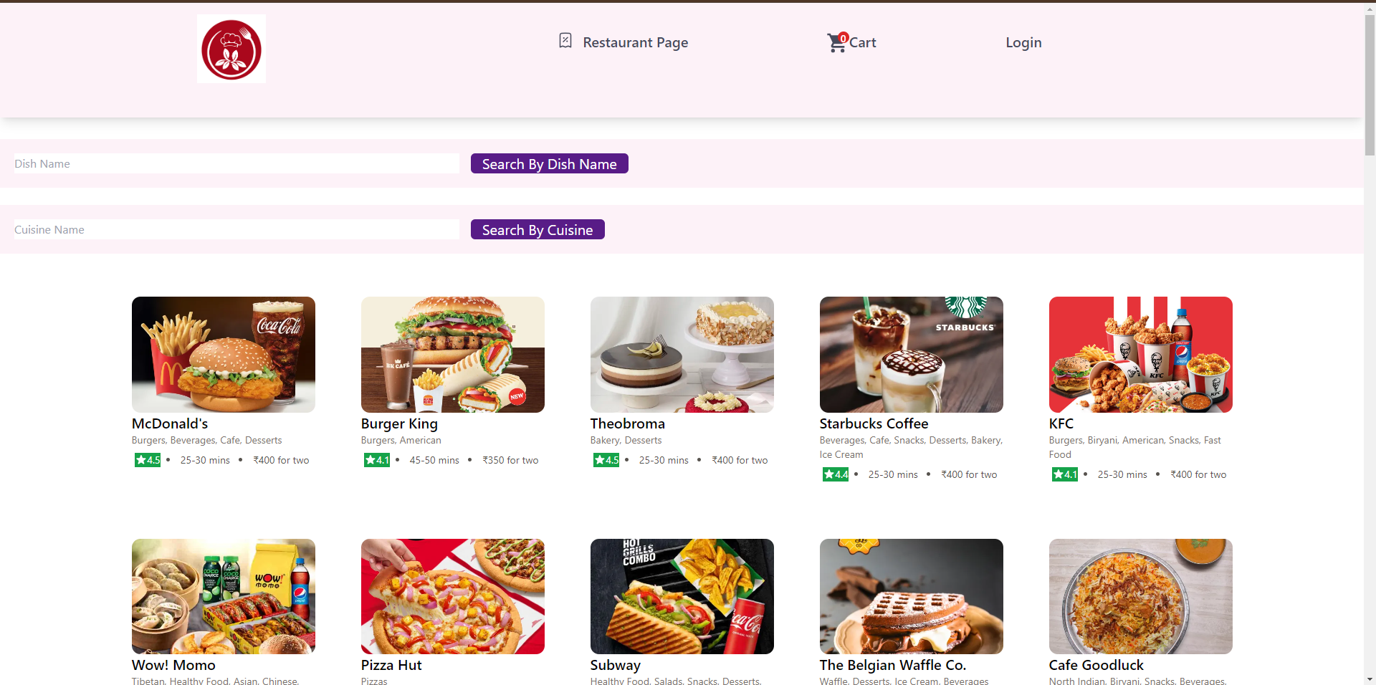
Food Ordering Application

Slide 2
PRESENTATION OUTLINE
PROBLEM DEFINITION
PROPOSED SOLUTION
OBJECTIVE OF THE SOLUTION
FEATURES
DEVELOPMENT TECHNOLOGIES
DEPLOYMENT TECHNOLOGY
FUTURE SCOPE

Slide 3
PROBLEM DEFINITION
Individuals face significant challenges in accessing a wide variety of dining options conveniently and efficiently.
Traditional methods of ordering food, such as dining in at restaurants or placing phone orders for delivery, have following problems
Time-consuming,
Limited in choice
Lack of a centralized platform for browsing menus, placing orders, and tracking deliveries.
As a result, there is a clear need for a comprehensive food delivery application that streamlines the process of ordering food, provides a diverse selection of restaurants and cuisines, offers transparent pricing and delivery options, and enhances overall convenience and satisfaction for users.

Slide 4
PROPOSED SOLUTION
Convenience: Users can browse through a diverse range of restaurants and cuisines conveniently from their smartphones or computers, eliminating the need to physically visit multiple locations or make phone calls to place orders.
Expanded Choices: The app provides access to a wide variety of dining options, including restaurants, cafes, fast food chains, and specialty cuisines, allowing users to explore and discover new dining experiences easily.
Transparent Information: Users can view detailed menus, prices, and delivery times for each restaurant, enabling them to make informed decisions based on their preferences, dietary restrictions, and budget constraints.

Slide 5
Features
CUSTOMER FEATURES
Customer can register himself
Customers can search for dish by name.
Customers can search foods by cuisine
Customers can add foods to their cart.
Customers can view their cart

Slide 6
RESTAURANT FEATURES
The restaurant can register itself.
The restaurant can add his food
The restaurant can view all its foods
The restaurant can update its food.
The Restaurant can view all its orders and update.

Slide 7
DEVELOPMENT TECHNOLOGIES :
DataBase Technologies :
MySql
Backend Technologies :
Java, Spring Boot, Spring data jpa
Spring security
Jwt role based authentication
Java mail api
Frontend Technologies :
Javascript, React.JS, Tailwind.
IDEs:
Spring Tool Suite (STS), Vs Code.

Slide 8
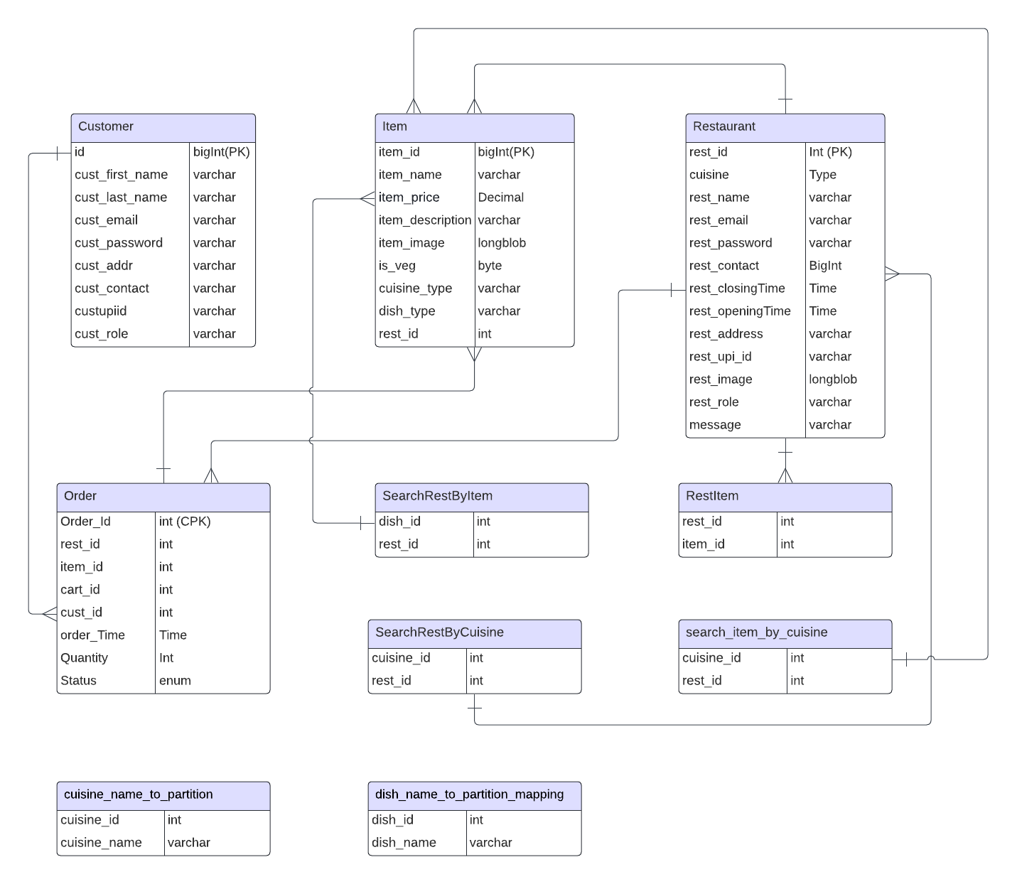
DataBase Design
ER Diagram

Slide 9
DataBase Partitioning
It is a technique for dividing a large table into smaller, more manageable sub-tables called partitions. Each partition holds a subset of the table's data based on a defined partitioning scheme. Although the data resides in separate partitions, MySQL treats the partitioned table as a single logical entity, allowing you to seamlessly query and manage it as if it were a unified whole.

Slide 10
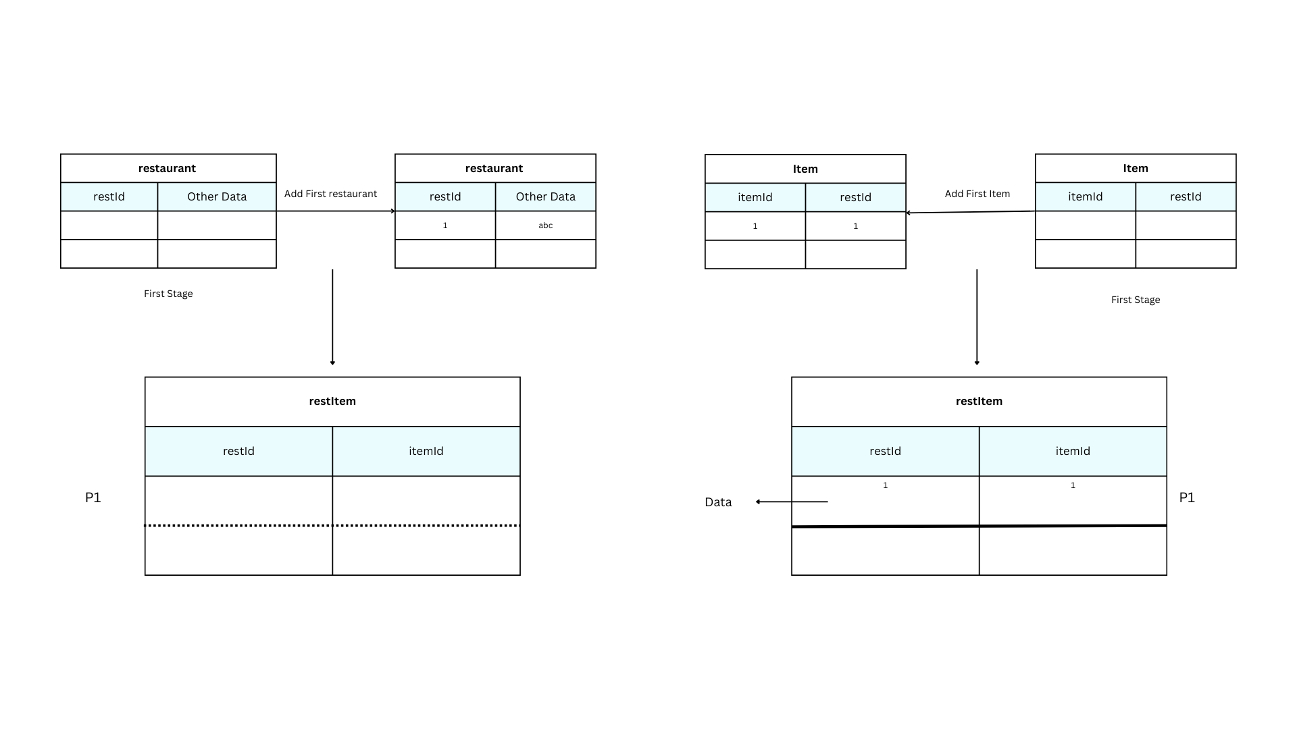

Slide 11
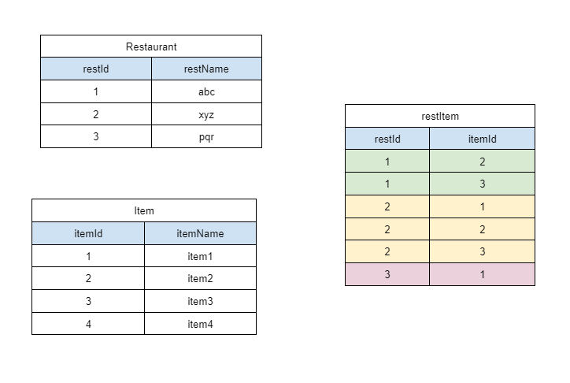

Slide 12
Pros
Improved performance: By targeting specific partitions for queries, you dramatically reduce the amount of data scanned, leading to faster query execution times and enhanced database responsiveness.
Enhanced manageability: Partitioning allows you to manage individual partitions separately, streamlining tasks like backups, maintenance, and optimization. You can back up or optimize a single partition without affecting the rest, minimizing downtime.
Scalability: As your data volume grows, you can easily add new partitions to accommodate it, scaling your storage capacity horizontally without impacting performance.

Slide 13
Cons
Increased complexity: Partitioning introduces additional management overhead. You need to design and implement the partitioning scheme, monitor partition sizes and growth, and consider the impact on queries involving multiple partitions.
Potential performance implications: If not designed carefully, partitioning can sometimes lead to slower queries, especially for complex joins across multiple partitions. It's crucial to choose the right partitioning scheme and query patterns to optimize performance.
Limited suitability for smaller tables: The benefits of partitioning become significant for large tables (in the range of billions of rows). For smaller tables or frequently updated data, the overhead of managing partitions might not be justified.
Compatibility considerations: Partitioning might not be fully supported by all MySQL versions or tools, so carefully evaluate compatibility before implementation.

Slide 14
Frontend

